Slide 1


Kuniadi Wandy Huang
31 October 2021

Slide 2

Outline
Executive Summary
Introduction
Methodology
Results
Conclusion
Appendix

Slide 3
Executive Summary
SpaceX is able to save cost of their rocket launch by reusing the launch’s first stage. For an alternate company to bid against SpaceX for a rocket launch, they would like to predict whether the first stage will land. If they can determine if the first stage will land, the cost of a launch can be determined
Historical launch data are collected from SpaceX API and SpaceX Wikipedia page. Data are mined and stored in cloud database. Exploratory Data Analysis (EDA) and data visualization was conducted using Python libraries.
Prediction of landing success was conducted using different Machine Learning model: Logistic Regression, Support Vector Machine, Decision Tree Classifier, and K Nearest Neighbors. All models show similar accuracy score of 83.3%

Slide 4
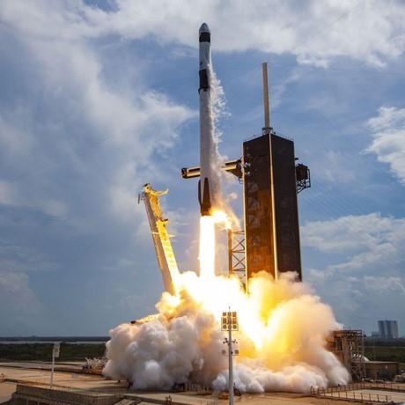
Introduction
SpaceX cost of its Falcon 9 rocket launch is ~100 million USD cheaper than other rocket provider because they can reuse the first stage.
For SpaceY to bid against SpaceX for a rocket launch, they need to know the cost of a launch by knowing whether first stage will land
From historical rocket launch data, SpaceY would like to know whether we can use Machine Learning models to predict the first stage of the rocket launch will be successful or not.

Slide 5


Slide 6
Methodology
Executive Summary
Data collection methodology:
Collect data from SpaceX API and Wikipedia
Perform data wrangling
Data obtained from SpaceX and Wikipedia is combined, removed and replaced missing values
Perform exploratory data analysis (EDA) using visualization and SQL
Perform interactive visual analytics using Folium and Plotly Dash
Perform predictive analysis using classification models
Different classification models are tested, evaluated, tuned, and compared

Slide 7
Data Collection – Executive Summary
SpaceX API data is collected using Requests, and SpaceX Wikipedia data is collected using Beautiful Soup.
In SpaceX API data, the features / columns are Flight Number, Date, Booster Version, Payload Mass, Orbit, Launch Site, Outcomes, Flights, Grid Fins, Reused, Landing Pad, Block, Reused Count, Serial, Longitude, and Latitude
In SpaceX Wikipedia page, the features / columns are

Slide 8
Data Collection – SpaceX API
SpaceX API URL: https://cf-courses-data.s3.us.cloud-object-storage.appdomain.cloud/IBM-DS0321EN-SkillsNetwork/datasets/API_call_spacex_api.json
GitHub URL of the completed SpaceX API calls notebook: https://github.com/setzerace/IBM-Data-Science-Capstone-Project-Huang/blob/main/Data%20collection.ipynb
Collect SpaceX API using Request
Convert data to pandas data frame
Parse the data frame to obtain booster, launch site, payload, and core data
Create a separate data frame containing only the parsed data
Filter the data frame to show Falcon 9 launches only
Replace missing values of payload with the mean values

Slide 9
Data Collection - Scraping
SpaceX Wikipedia URL: https://en.wikipedia.org/wiki/List_of_Falcon_9_and_Falcon_Heavy_launches
GitHub URL of the completed SpaceX Wikipedia notebook: https://github.com/setzerace/IBM-Data-Science-Capstone-Project-Huang/blob/main/data%20collection%20with%20webscraping.ipynb
Scrap SpaceX Wikipedia using Requests and Beautiful Soup
Extract all column/variable names from the HTML table header
Create an empty dictionary called launch_dict
Fill in the parsed launch record values into launch_dict
Create a data frame from the parsed launch_dict

Slide 10
Data Wrangling
Some data contains alphabetical value, instead of numerical one. Data wrangling aims to convert this data into usable format before Exploratory Data Analysis (EDA)
GitHub URL of the completed data wrangling notebook: https://github.com/setzerace/IBM-Data-Science-Capstone-Project-Huang/blob/main/Data%20wrangling.ipynb
Identify the number of launches on different sites
Counts the number of orbits and their occurence
Identify the mission outcomes variation: Success/ failure, landing location
Label Landing outcomes to numerical value: 0 for failure; 1 for success
Assign landing outcomes to new column “Class” and append it to existing dataframe

Slide 11
EDA with Data Visualization
The following charts are used:
Scatter Chart: Payload vs Flight number, Launch Site vs Flight number, Launch Site vs Payload mass, Orbit vs Flight number, Orbit vs Payload mass
Bar Chart: Class vs Orbit
We use scatter chart to observe and show relationships between two numeric variables, and bar chart to compare things between different groups
GitHub URL of the completed EDA notebook: https://github.com/setzerace/IBM-Data-Science-Capstone-Project-Huang/blob/main/Data%20visualization.ipynb

Slide 12
EDA with SQL
The following SQL queries was done during EDA:
Identify unique launch sites
Identify launch sites begin with the string 'CCA’
Calculate total and average payload mass carried by boosters launched by NASA (CRS) using SUM and AVERAGE, respectively
Identify the date of first successful landing in ground pad
Identify boosters used in successful landing at drone ship with 4,000 ≤ payload mass ≤ 6,000
Identify the total number and individual number of successful and failure mission outcomes at different landing sites
GitHub URL of the completed EDA with SQL notebook: https://github.com/setzerace/IBM-Data-Science-Capstone-Project-Huang/blob/main/EDA%20with%20SQL.ipynb

Slide 13
Build an Interactive Map with Folium
Folium is used to mark locations of all launch sites, which landing site is a success or a failure, and calculate the distance between launch sites and nearest coastline, railway, highway, and city
The following marker are used: circle, cluster, and line
GitHub URL of the completed Folium notebook: https://github.com/setzerace/IBM-Data-Science-Capstone-Project-Huang/blob/main/Folium%20and%20data%20visualization.ipynb

Slide 14
Build a Dashboard with Plotly Dash
Two charts were created with the following purpose:
Pie chart: To compare the landing success rate of all sites and individual sites
Scatter chart: To identify the correlation between payload and the success rate of different sites. Slider were added, so the charts can be adjusted at different payload mass range
GitHub URL of the completed plotly dash program: https://github.com/setzerace/IBM-Data-Science-Capstone-Project-Huang/blob/main/spacex_dash_app.py

Slide 15
Predictive Analysis (Classification)
Different classification model was used: Log Regression, SVM, Decision Tree, and KNN
Models are optimized and the performance were compared based on its accuracy score
GitHub URL of the completed predictive analysis notebook: https://github.com/setzerace/IBM-Data-Science-Capstone-Project-Huang/blob/main/Predictive%20Analysis%20(Classification).ipynb
Create variable Y from “Class” column as independent variable
Create variable X from the remaining columns as dependent variables
Standardize X using Standard Scaler
Split both X and Y to test and train data
Use train data to train all classification models (LogRes, SVM, Tree, KNN)
Use Grid Search to find the optimal hyperparameters for each models
Use optimized models to predict test data
Measure the accuracy of all models using accuracy score and confusion matrix

Slide 16
Results
Exploratory data analysis results
Interactive analytics demo in screenshots
Predictive analysis results

Slide 17


Slide 18
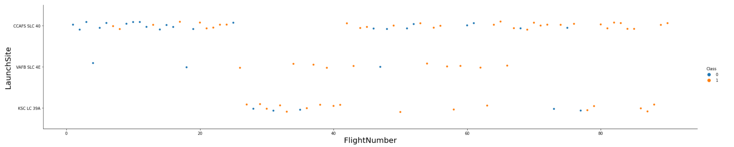
Flight Number vs. Launch Site
The graph shows that the success rate of the landing increases with flight number
There is no obvious relation between the location of launch sites with the success rate
Launching sites CCAFS SLC 40 is the most often used sites

Slide 19
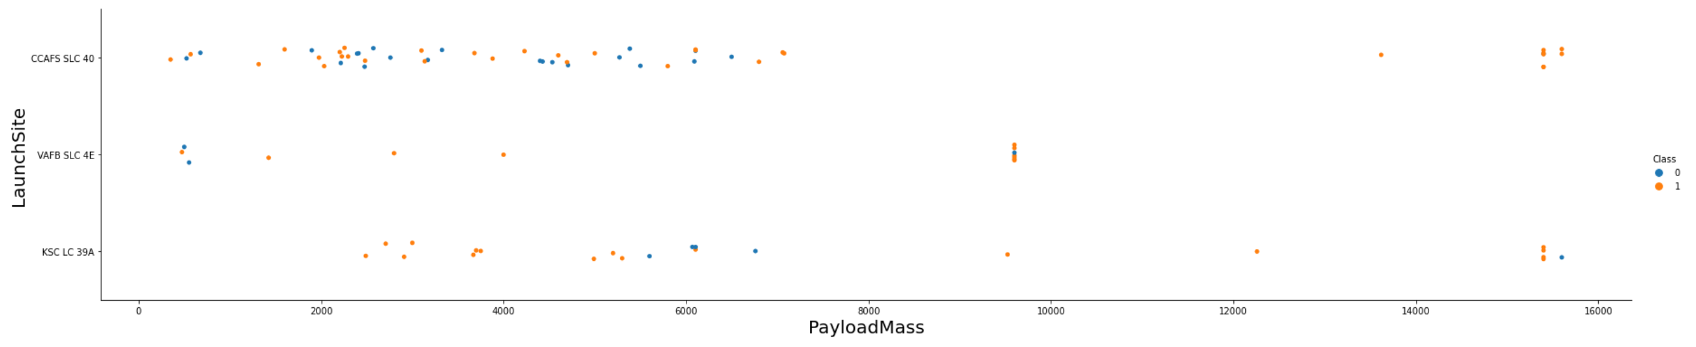
Payload vs. Launch Site
The graph shows that the success rate of the landing is the highest at payload above 14,000
Launch site VAFB SLC 4E is not used for rocket with payload mass above 10,000

Slide 20
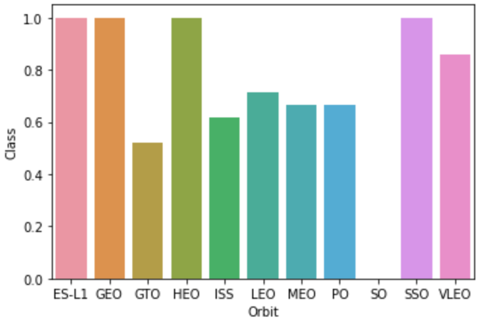
Success Rate vs. Orbit Type
Orbit ES-L1, GEO, HEO, and SSO have 100% success rate, followed by VLEO with the second highest at 80% success rate
Orbit GTO has the lowest success rate of 50%
Other orbits (ISS, LEO, MEO, and PO) has a success rate ranged between 60 – 70%

Slide 21
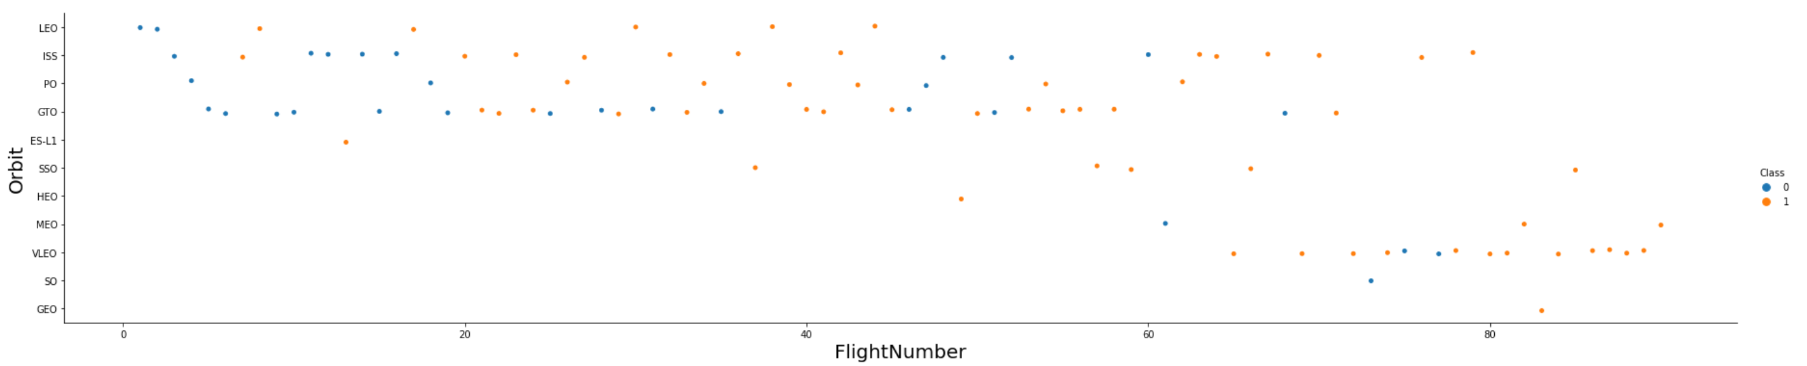
Flight Number vs. Orbit Type
The graph shows that the success rate of LEO orbit is related with the number of flights
In the beginning of launch (flight number less than 60) , LEO, ISS, PO, and GTO orbit are often selected
After flight number higher than 60, the launch started to shift to VLEO orbit

Slide 22
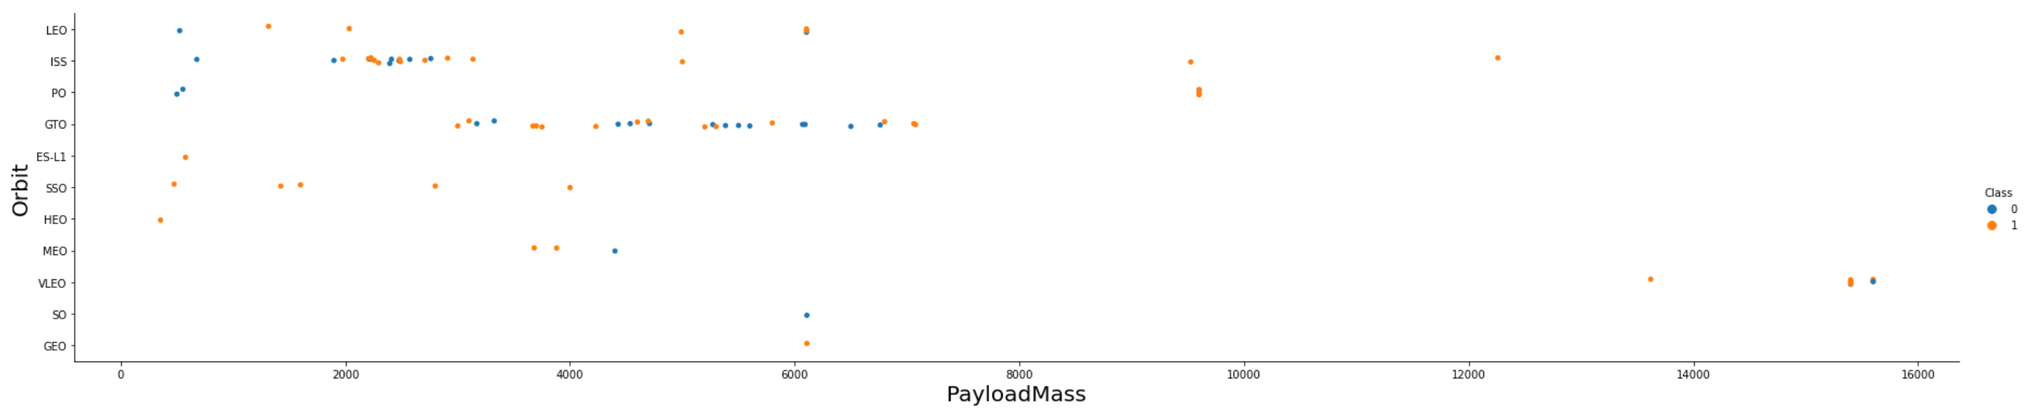
Payload vs. Orbit Type
For orbit LEO, ISS, and POLAR, success rate increases at higher payload mass
At payload higher than 13,000, only orbit VLEO is used
Orbit SSO has 100% success rate, and only tested at payload less than or equal to 4,000

Slide 23
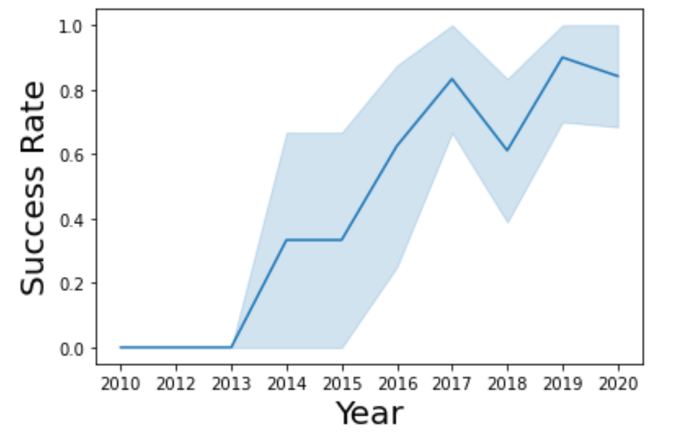
Launch Success Yearly Trend
Success rate of the launch increases over time, starting from year 2013 to year 2020
There is setback of success rate in 2018, where it decreases from around 80% to 60%. However, it recovers back to 90% in 2019

Slide 24
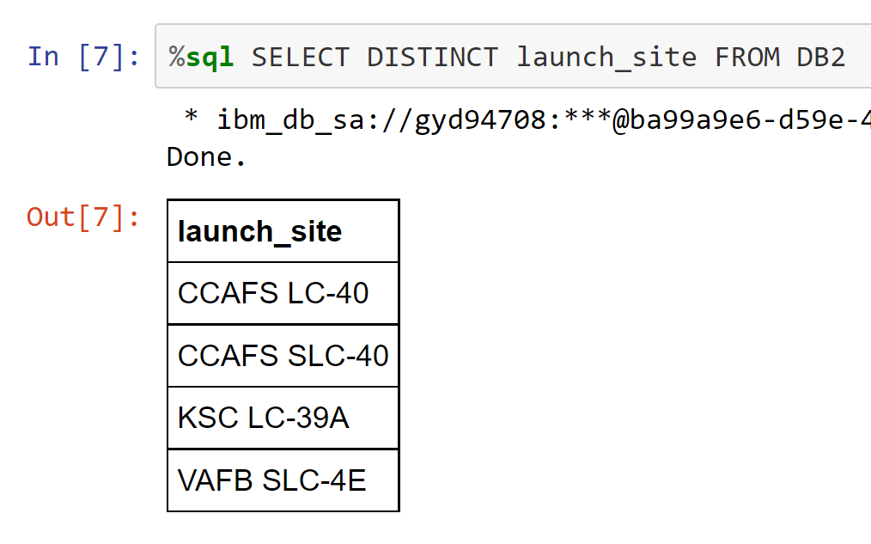
All Launch Site Names
There are 4 launch sites:
CCAFS LC-40
CCAFS SLC-40
KSC LC-39A
VAFB SLC-4E

Slide 25
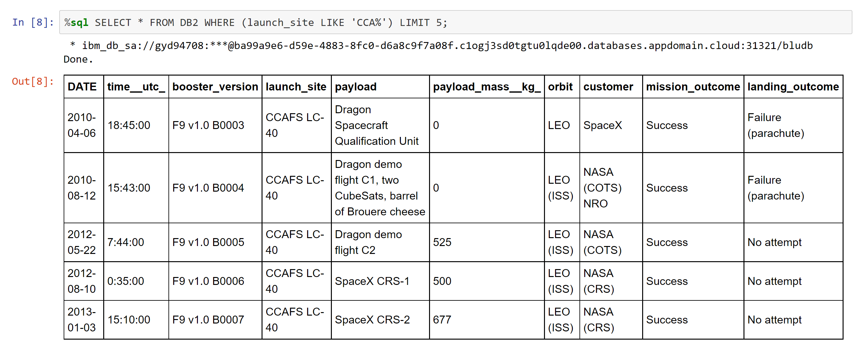
Launch Site Names Begin with 'CCA'
The earliest record where launch sites names begin with ‘CCA’ is in 2010
All earliest record of site names begin with ‘CCA’ are either a failure or no attempt

Slide 26
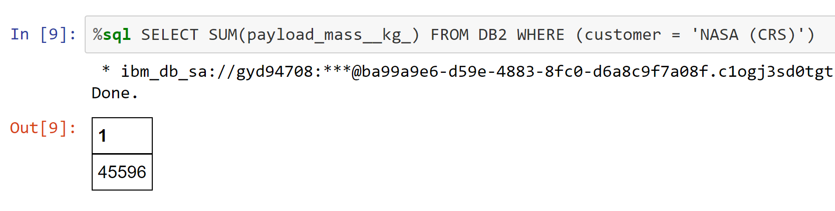
Total Payload Mass
The total payload mass carried by boosters from NASA is 45,596 kg

Slide 27
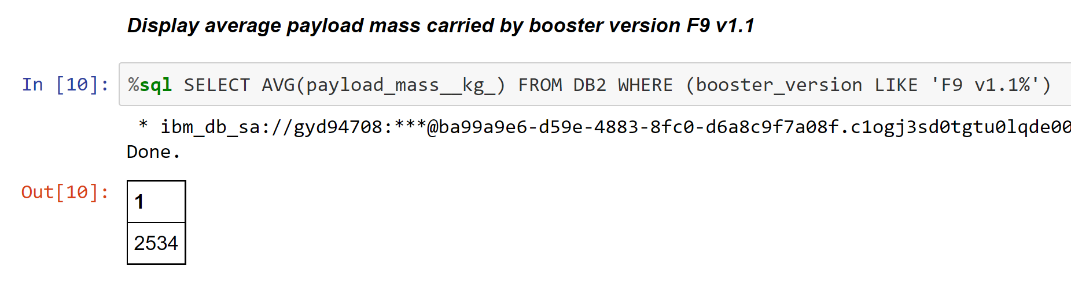
Average Payload Mass by F9 v1.1
The average payload mass carried by boosters from NASA is 2,534 kg

Slide 28
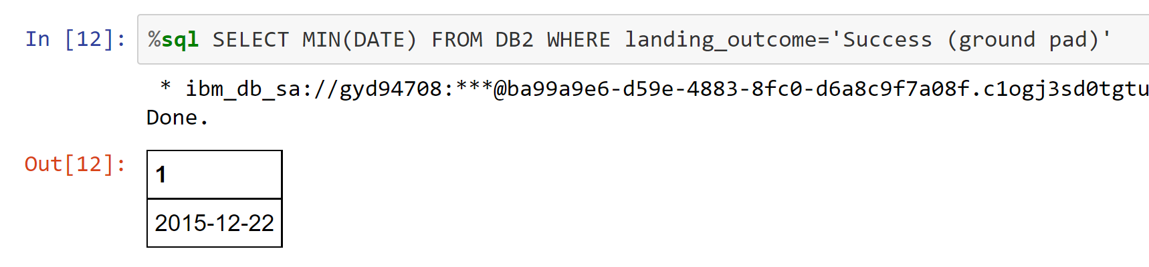
First Successful Ground Landing Date
The first successful landing on ground pad is in 2015, 5 years since the first launch testing

Slide 29
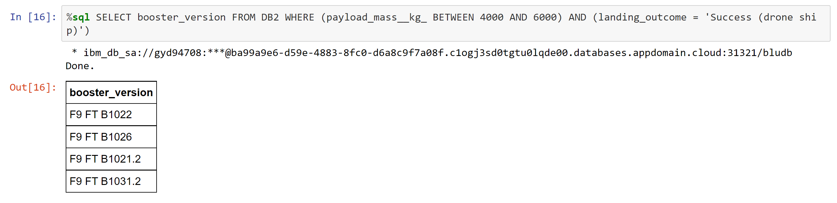
Successful Drone Ship Landing with Payload between 4000 and 6000
There are 4 types of boosters with 4000 ≤ payload mass ≤ 6000 had been used during successful drone ship landing:
F9 FT B1022
F9 FT B1026
F9 FT B1021.2
F9 FT B1031.2

Slide 30
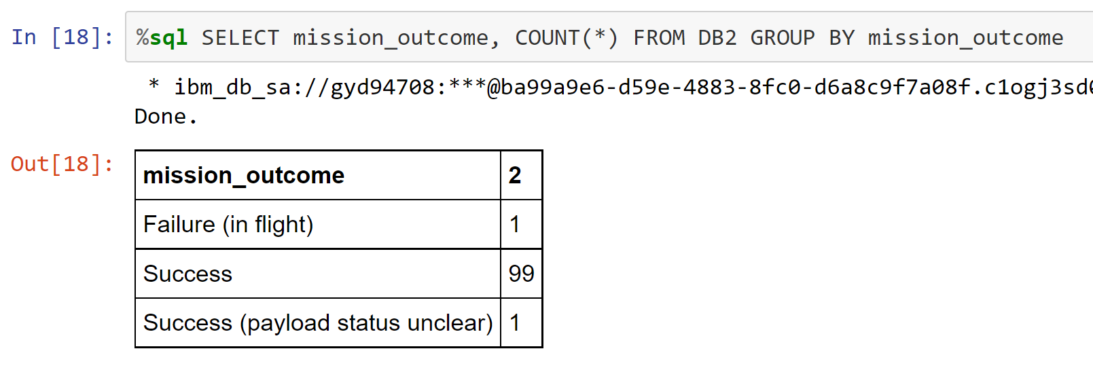
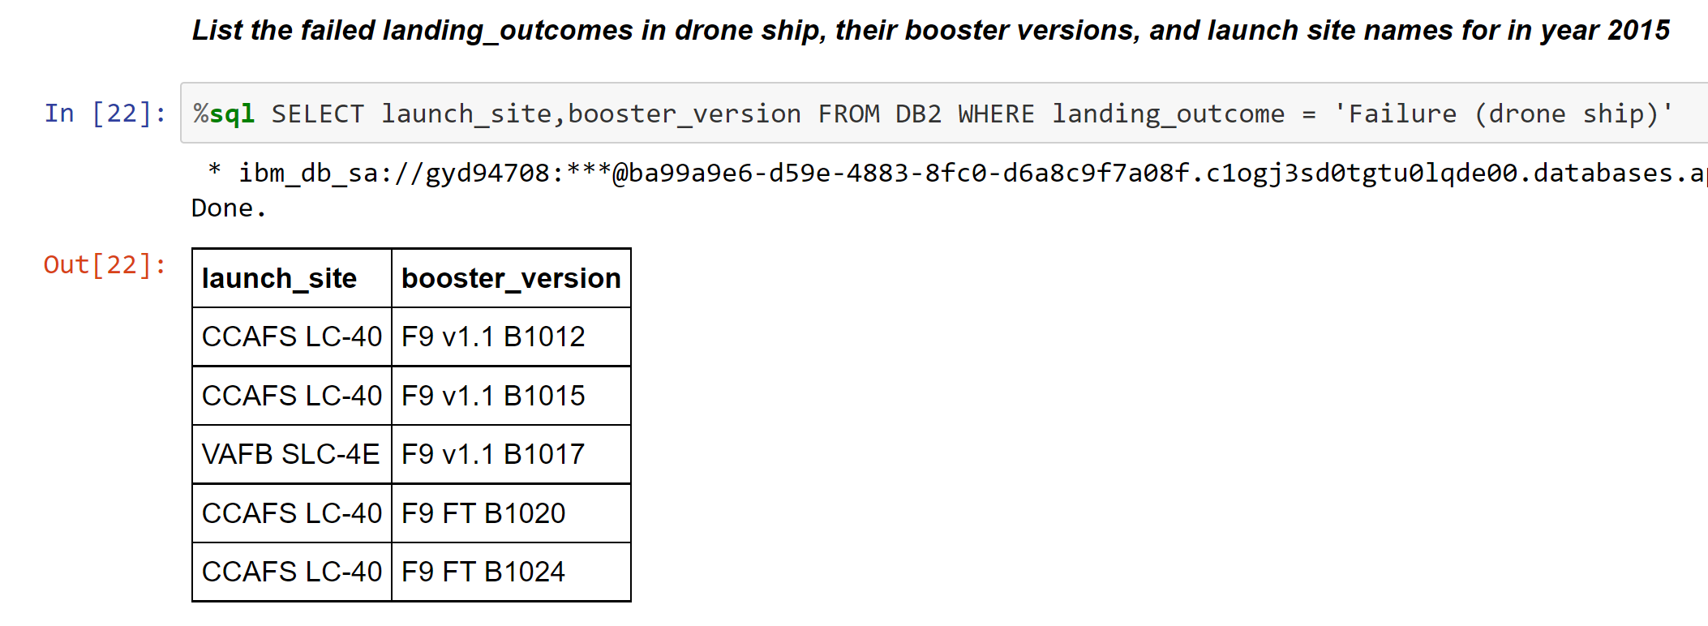
Total Number of Successful and Failure Mission Outcomes
The total number of successful mission is close to 100%, regardless whether the landing of stage 1 is successful or not
There is only 1 flight resulting in a failure

Slide 31
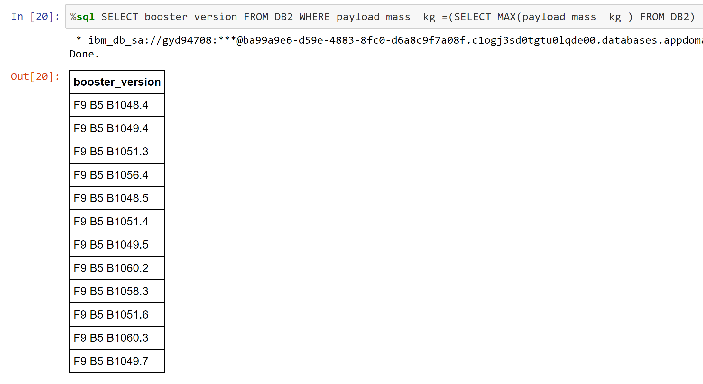
Boosters Carried Maximum Payload
There are total of 12 booster versions carries the highest payload, at 15,600 kg

Slide 32
2015 Launch Records
There are 2 launch sites where landing outcomes at drone ship is a failure: CCAFS LC-40 and VAFB SLC-4E
There are 5 types of booster versions had been used during failure landing at drone ship

Slide 33
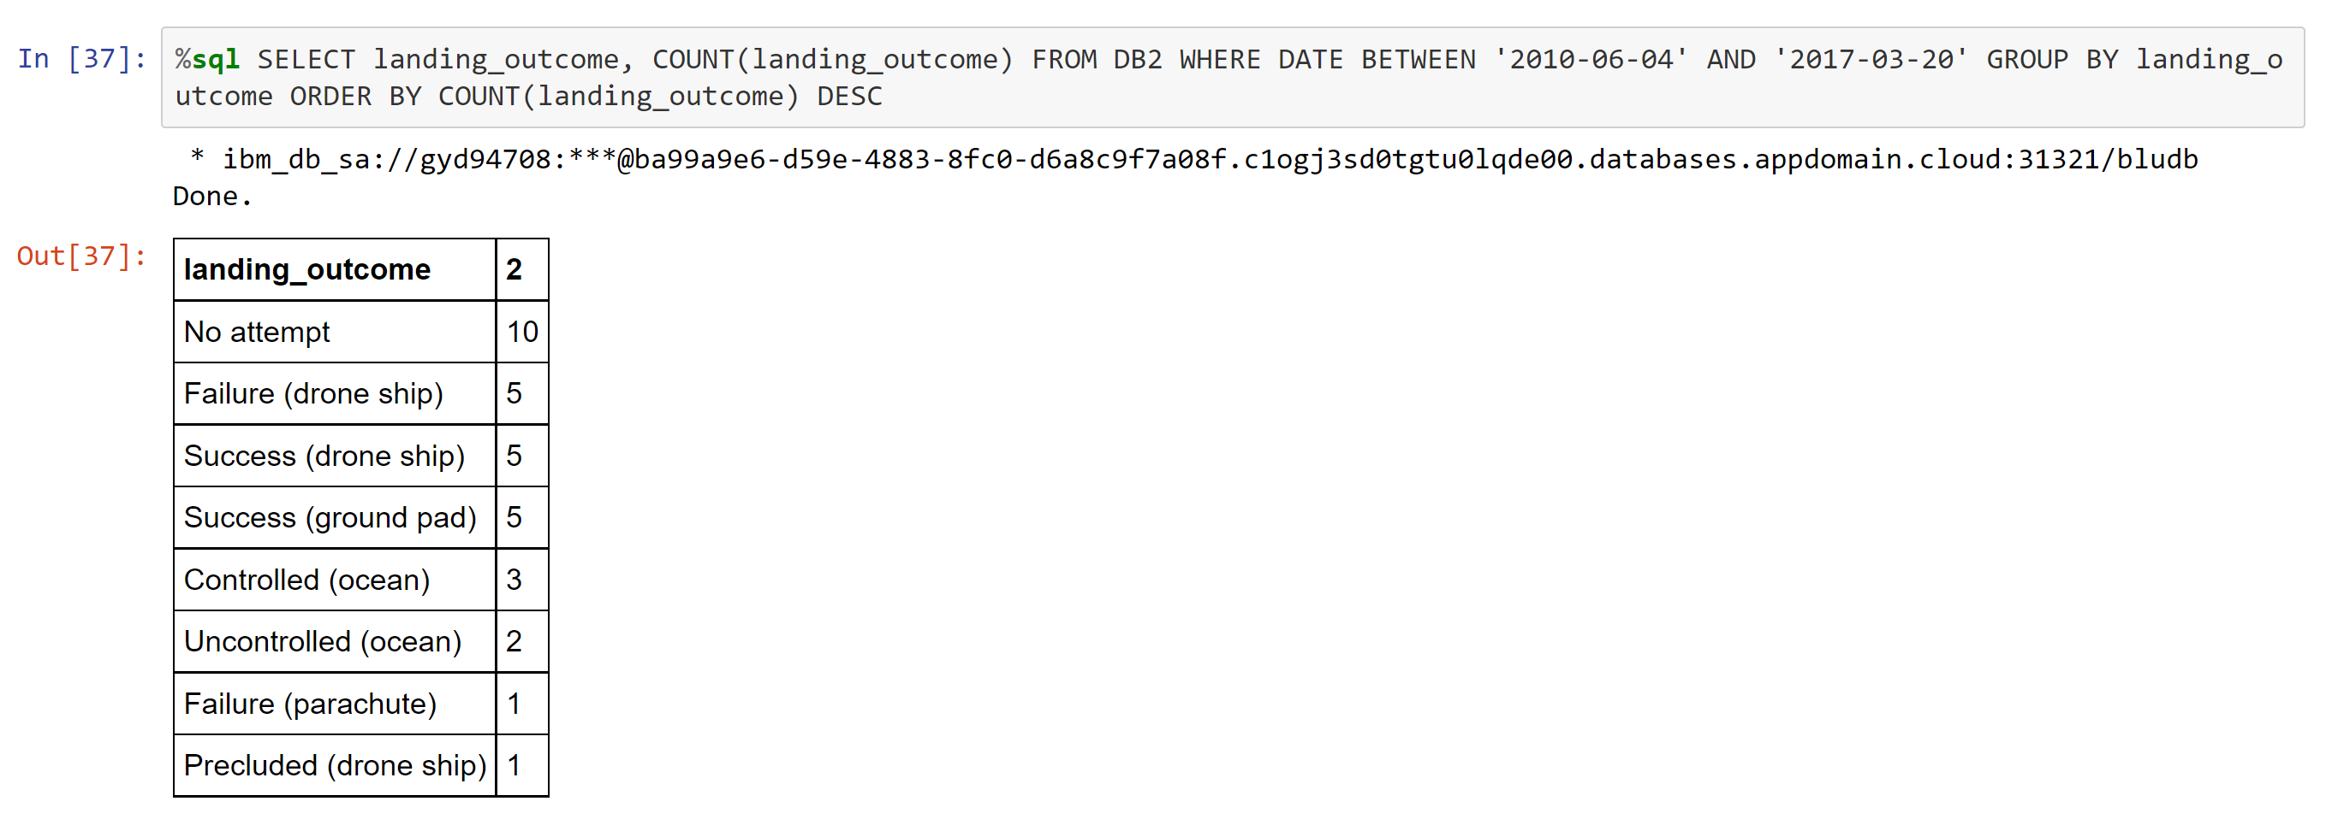
Rank Landing Outcomes Between 2010-06-04 and 2017-03-20
The top three highest rank of landing outcomes between 2010 and 2017 are ‘No Attempt’, followed by ‘Failure at drone ship’ and Success at drone ship’

Slide 34


Slide 35
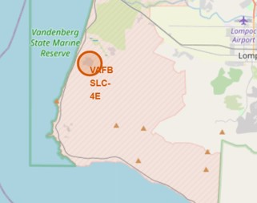
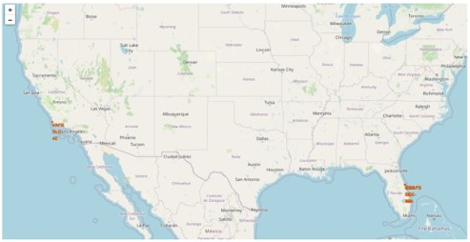
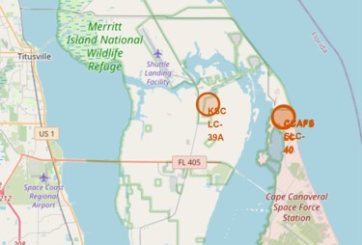
Locations of All Launch Sites on a Map
There are total of 4 launch locations in the US: One is in the west of USA, and three are in the east of USA
VAFB SLC-4E is located in the west USA, while CCAFS LC-40, CCAFS SLC-40, and KSC LC-39A are located in the east of USA

Slide 36
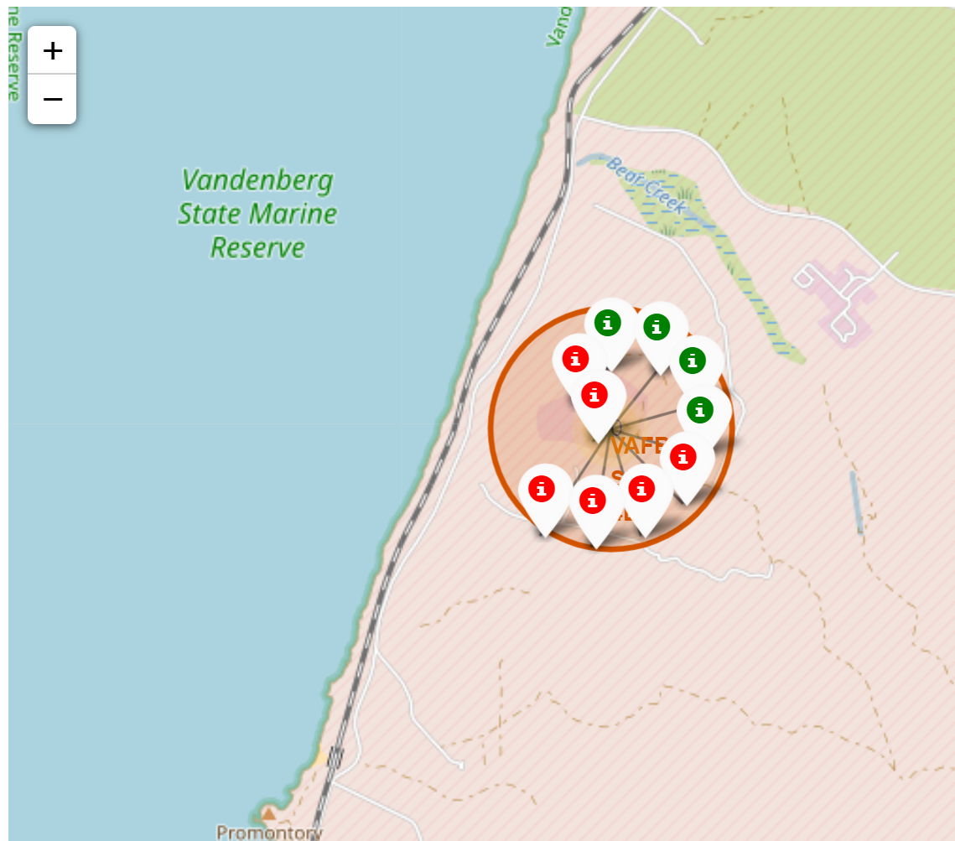
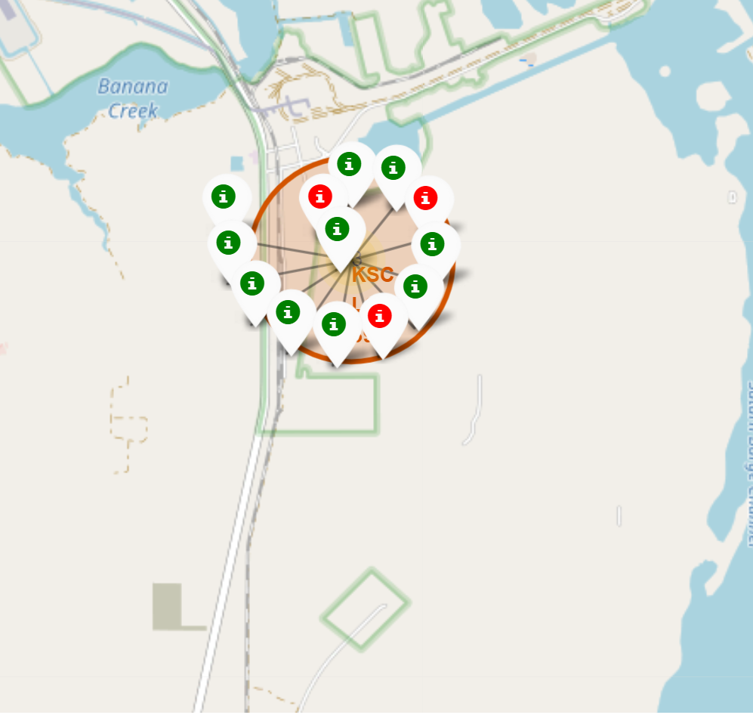
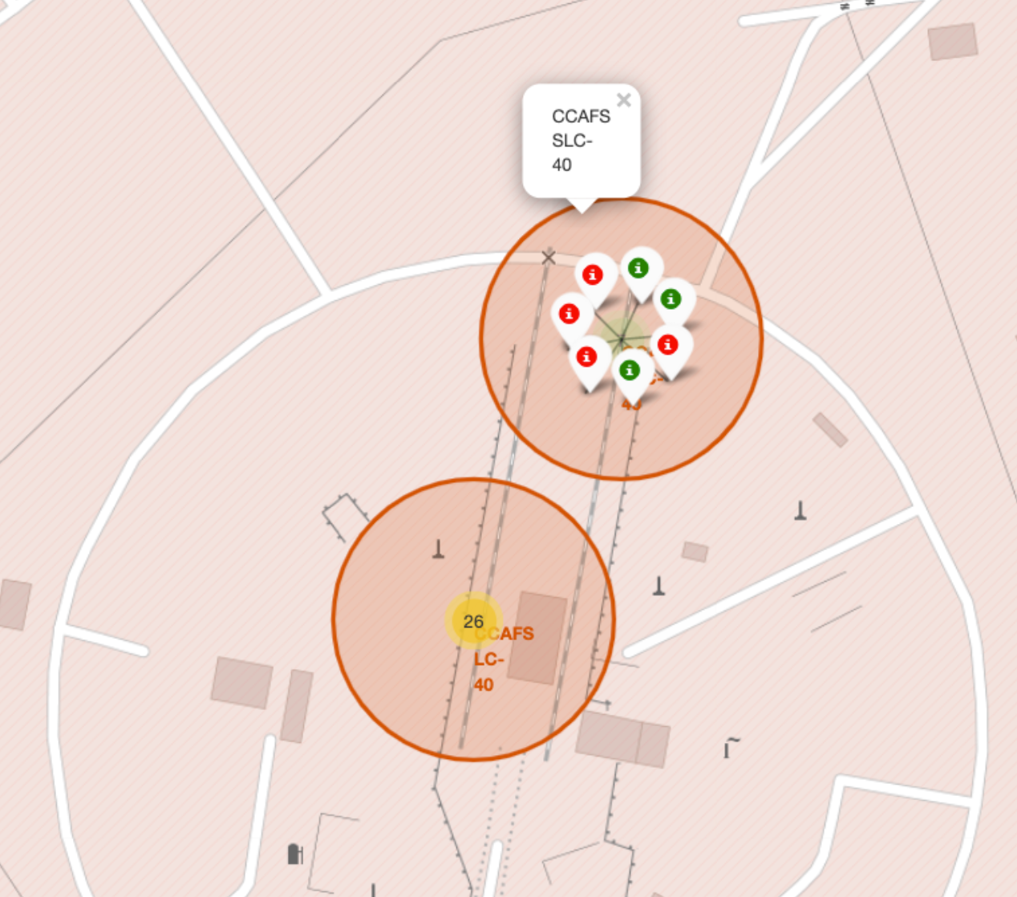
Success/Failed Launch Markers for Every Sites
KSC LC-39A: Highest success rate
Between all launch sites, KSC LC-39A has the highest success rate of launching sites, with only 3 failures out of 13 launches (see middle figure)

Slide 37
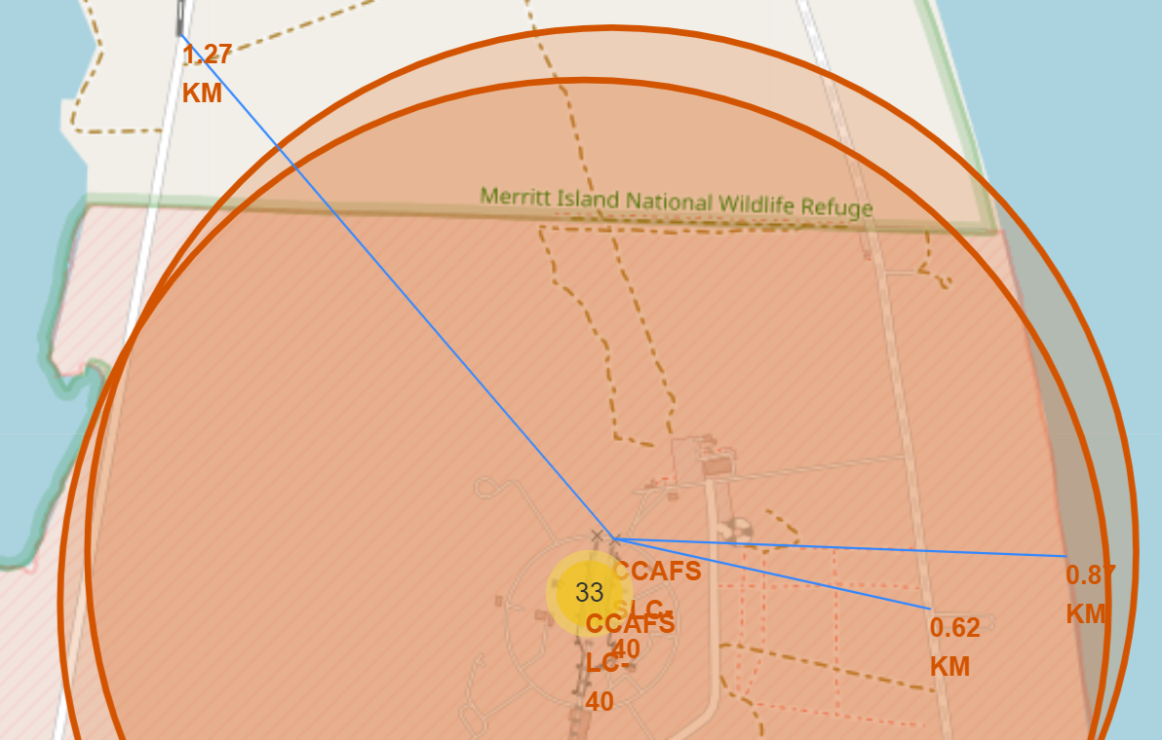
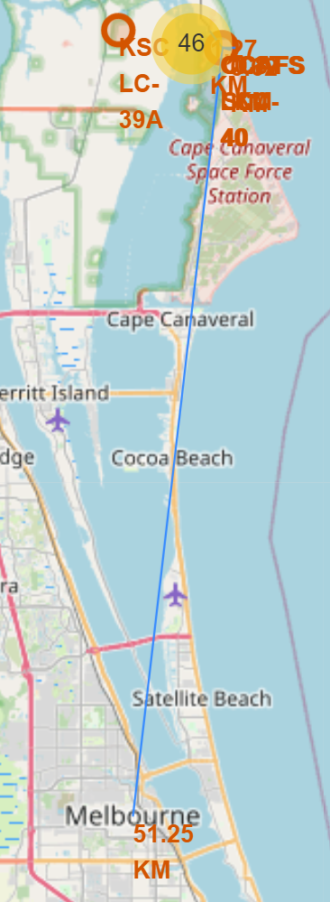
Distances between a launch site to its proximities
The distance between launching site CAFS LC-40 to nearest coast is 0.87 km
The distance between launching site CAFS LC-40 to nearest railway is 1.27 km
The distance between launching site CAFS LC-40 to nearest highway is 0.62 km
The distance between launching site CAFS LC-40 to Melbourne city is 51.25 km
Fig.1 Distance between launching site CAFS LC-40 and coast, railway, highway
Fig.2 Distance between launching site CAFS LC-40 to Melbourne city

Slide 38


Slide 39
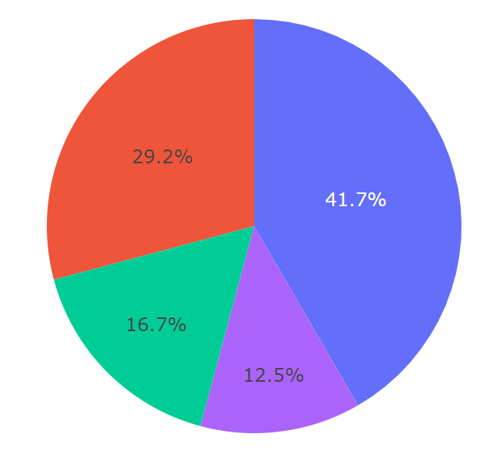
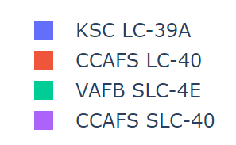
Total Success Rate of Launches of All Sites
KSC LC-39A has the highest success rate between all launching sites, at 41.7%

Slide 40
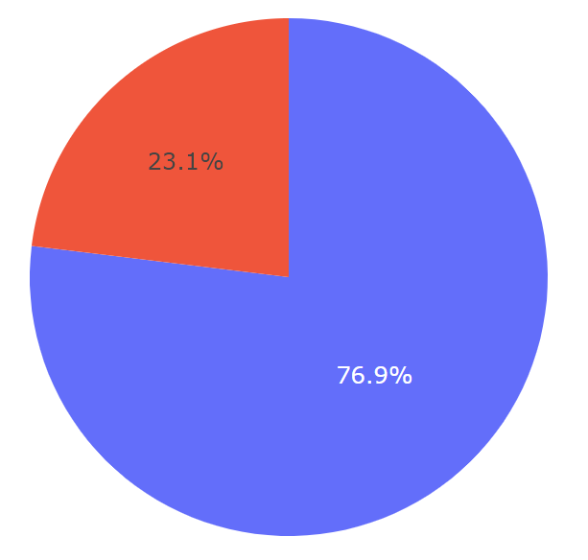
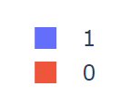
Total Success Rate of Launches of Site KSC LC-39A
KSC LC-39A has the highest success rate of launching sites, with only 3 failures out of 13 launches. The total success rate of this site is 76.9%

Slide 41
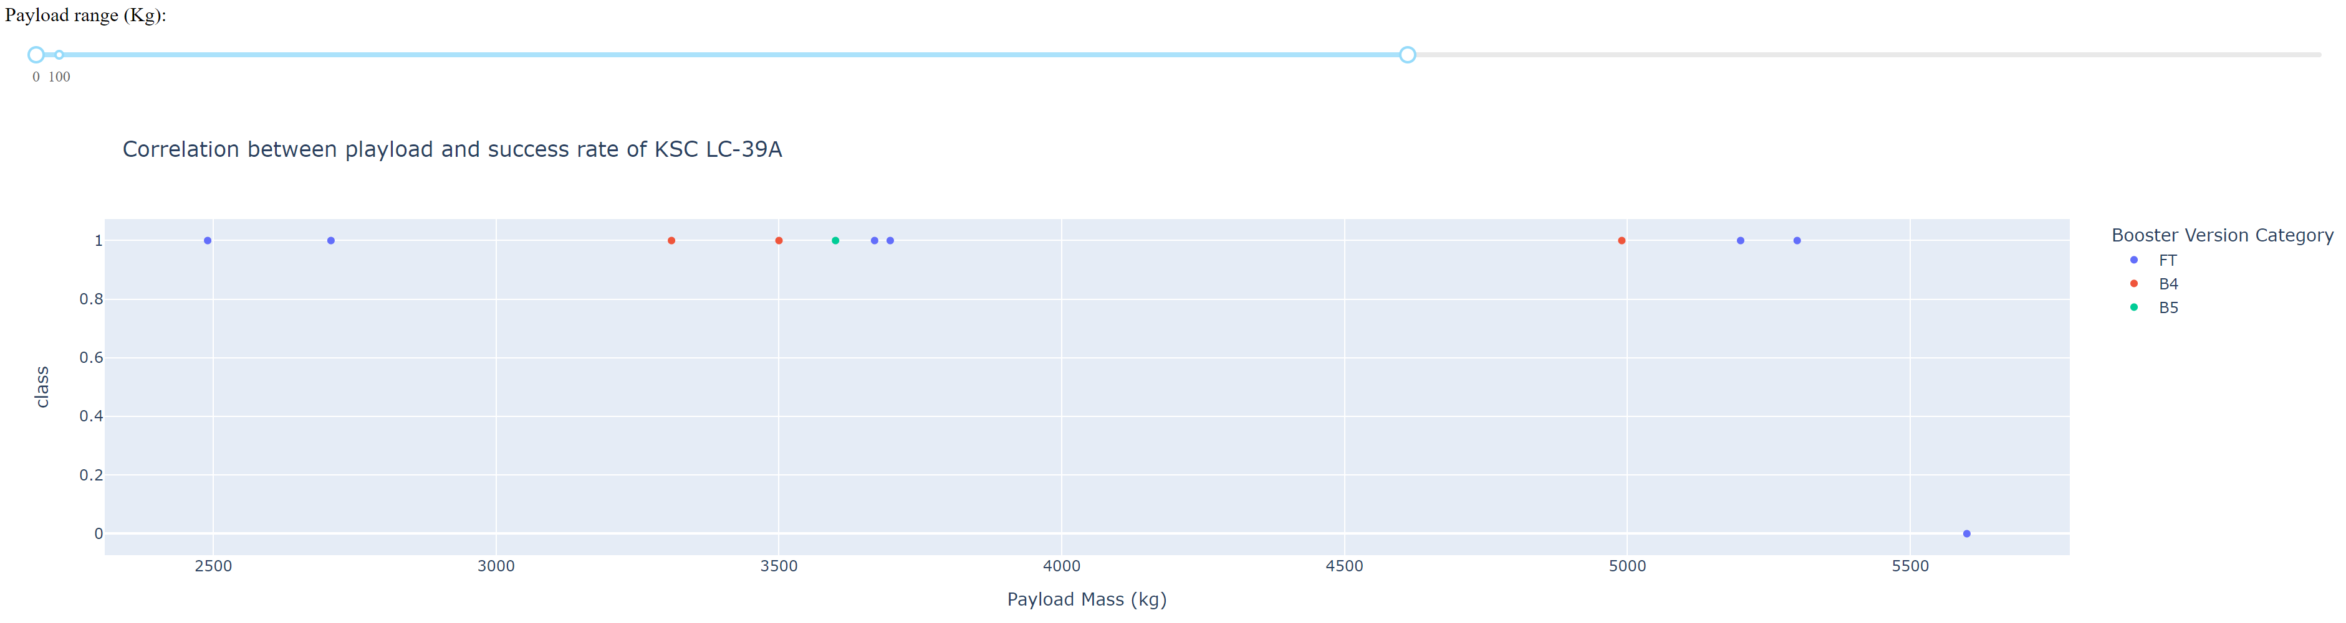
Correlation Between Payload & Success Rate of KSC LC-39A
Booster FT can used at wide range of payload, which can be as low as 2,500 kg and as high as 5,500 kg
At payload below 5,500 kg, booster B4 and B5 has a 100% success rate, although the number of samples are limited
Booster B5 is only used once at payload below 5,000 kg

Slide 42


Slide 43

Classification Accuracy
All 4 models (lor regression, SVM, decision tree, and KNN) showed similar accuracy score, at 83.3%
The number of data is rather small, at 90 samples. At test size of 20%, the test data used is only 18 samples
More data is recommended to determine the best classification model for this problem

Slide 44

Confusion Matrix
Because all models showing same accuracy, the confusion of matrix of all models showed the same results
There are 12 True Positive and 3 True Negative results
There are 3 False Positive and 0 False Negative results from the model, which contribute to the error in accuracy

Slide 45
Conclusions
We managed to collect the SpaceX API and Wikipedia using Requests and Beautiful Soup libraries
The data is wrangled, cleaned, and stored in Db2 cloud database for easier data management
From EDA, we managed to identify that there is relation between Launch Site vs Flight Number, between Landing Success Rate vs Payload Mass, and between Landing Success Rate vs Orbit
By creating Pie chart, we managed to identify that KSC LC-39A has the highest success rate between all of launching sites, with the success rate of 76.9%
We developed machine learning models to predict whether a launch will have a successful Stage , with the accuracy of 83.3%
SpaceY will be able to predict the success rate of landing site with a good accuracy, to compete with SpaceX for the next bidding

Slide 46
Appendix
My Github Repository URL:
https://github.com/setzerace/IBM-Data-Science-Capstone-Project-Huang

Slide 47


